Slide 1
Important features of gymnosperms
Gymnosperms (gymnos - naked, sperma = seed) are naked - seeded plants.
These group of plants have ovules are not enclosed and thus the seeds remain naked.
Most of the gymnosperms are evergreen, woody perennials with shrubby or tree like habit, but seldom vines.
They show xerophytic characters.
Many of them are very large in size.
The gymnosperms are the most ancient seed-bearing vascular plants that do not bear flowers, barring a few exceptions. They do not bear fruit.
The ovules are on scales, which are arranged in the cone-like structures. Gymnosperms rely on the airborne transport of their pollen, and most produce huge amounts of pollen.
/

Slide 2
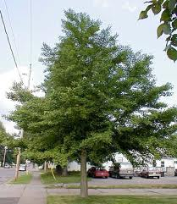
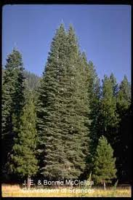
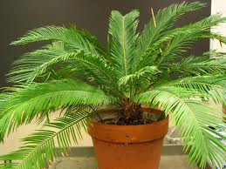
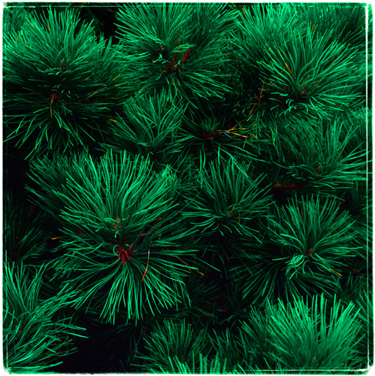
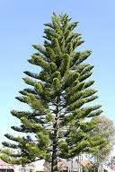
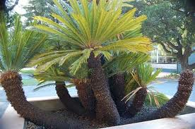

Slide 3
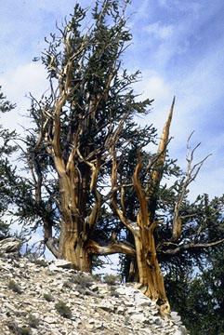
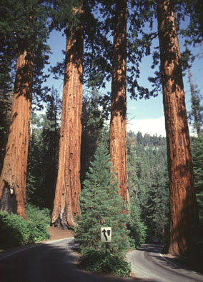
One fascinating fact about gymnosperms is that this group includes the oldest and largest trees known.
The Bristle Cone Pine, some of which are over 4,000 years old, are the oldest living plants. The Giant Redwood, which can reach over 300 feet tall, are the tallest plants known. Both these plants are native to California.
Bristle Cone Pine
Giant Redwood

Slide 4
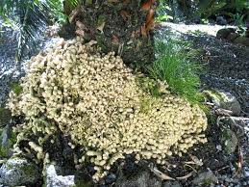
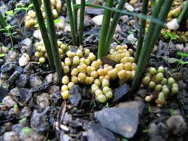
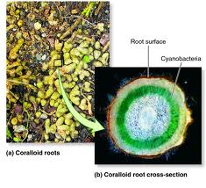
The main plant body is a well differentiated sporophyte consisting of roots, stem and leaves.
Plants possess well developed tap root system. The coralloid roots present in Cycas are associated with nitrogen-fixing cyanobacteria.
They are produced in clusters at the base of the stem and protrude out over the ground.
They are greenish brown and dichotomously branched. The root cortex contains an algal zone of blue green algae (Nostoc and Anabaena) which grow in symbiotic association with coralloid root.

Slide 5
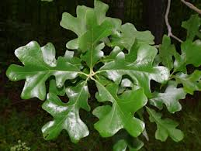
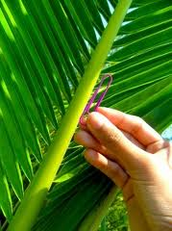
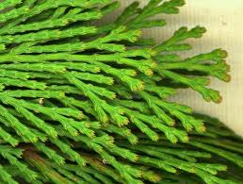
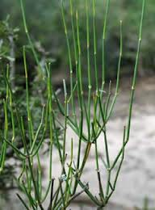
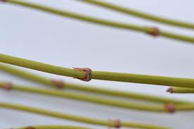
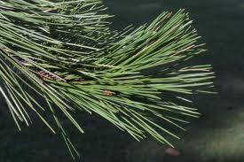
Leaves are of two types i.e. foliage leaves and scale leaves and can be simple (as in Pinus) or compound (pinnate in Cycas).
To help conserve water the leaves of few species are needle like ( flat leaves) with a waxy coating, thick cuticle and sunken stomata. These help in preventing water loss.
Foliage leaves
Needle like leaves
Scale leaves

Slide 6
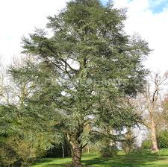
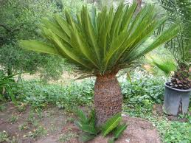
The stem can be branched (as in Pinus and Cedrus) or un-branched (as in Cycas).
Secondary growth takes place both in roots and stems. The xylem form the wood if a tree and the phloem tissues are part of the bark (along with cork).
Branched gymnosperm
Unbranched gymnosperm

Slide 7
Groups of Gymnosperm
The Gymnosperm are divided in four different groups/divisions: Cycadophyta, Ginkgophyta, Pinophyta, and Gnetophyta.
Among the gymnosperms are plants with stems that may barely project above the ground and others that develop into the largest of trees.

Slide 8
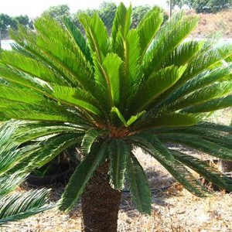
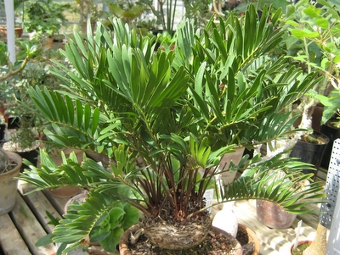
Cycads resemble palm trees, with fleshy stems and leathery, featherlike leaves. The tallest cycads reach 19 metres (62 feet).
Zamia integrifolia, a cycad native to Florida, Georgia, and the West Indies, has a short underground stem with the leaf-bearing tip, at most, exposed.
Cycas
Zamia

Slide 9
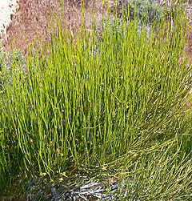
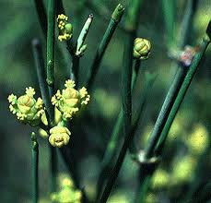
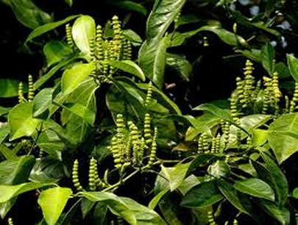
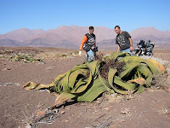
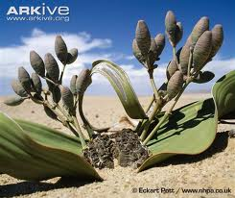
Of the gnetophytes, Ephedra (joint fir) is a shrub and some species of Gnetum are vines, while the unusual Welwitschia has a massive, squat stem that rises a short distance above the ground. The apex is about 60 centimetres in diameter. From the edge of the disk-shaped stem apex arise two leathery, straplike leaves that grow from the base and survive for the life of the plant.
Ephedra
Gnetum
Welwitschia

Slide 10
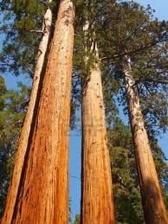
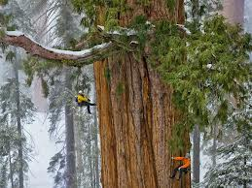
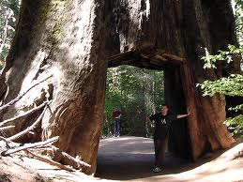
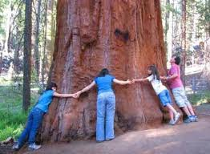
Most gymnosperms, however, are trees. Of the conifers, the redwoods (Sequoia) exceed 100 metres in height, and, although Sequoiadendron (giant redwood) is not as tall, its trunk is more massive

Slide 11
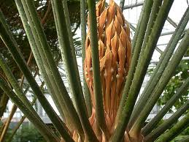
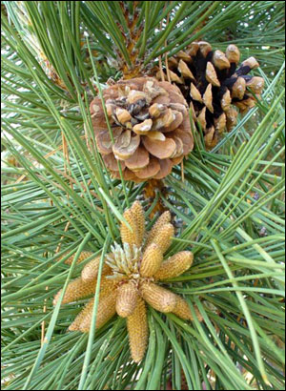
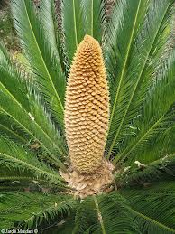
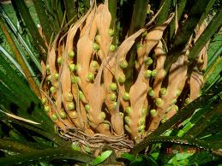
Reproduction
Gymnosperms are heterosporous. They bear two kinds of spores - microspores and megaspores. The microsporophylls and megasporophylls are arranged to form compact male and female cones.
Pinus female cone
Cycas female cone
Cycas male cone
Pinus male cone

Slide 12
Numerous spores are produced in the sporangia of the male cone which develops into pollen or microsporangium.
Each pollen at maturity consists of two sperm cells. Large number of pollen is released from the plant during the breeding season (which at times causes allergy to human and animals).
In the female cone is a structure, the ovule, that contains the megasporangium. The integument of the ovule protects the megasporangium.
An opening in the integument, the micropyle. A space between the micropyle and the megasporangium is called the pollen chamber.

Slide 13
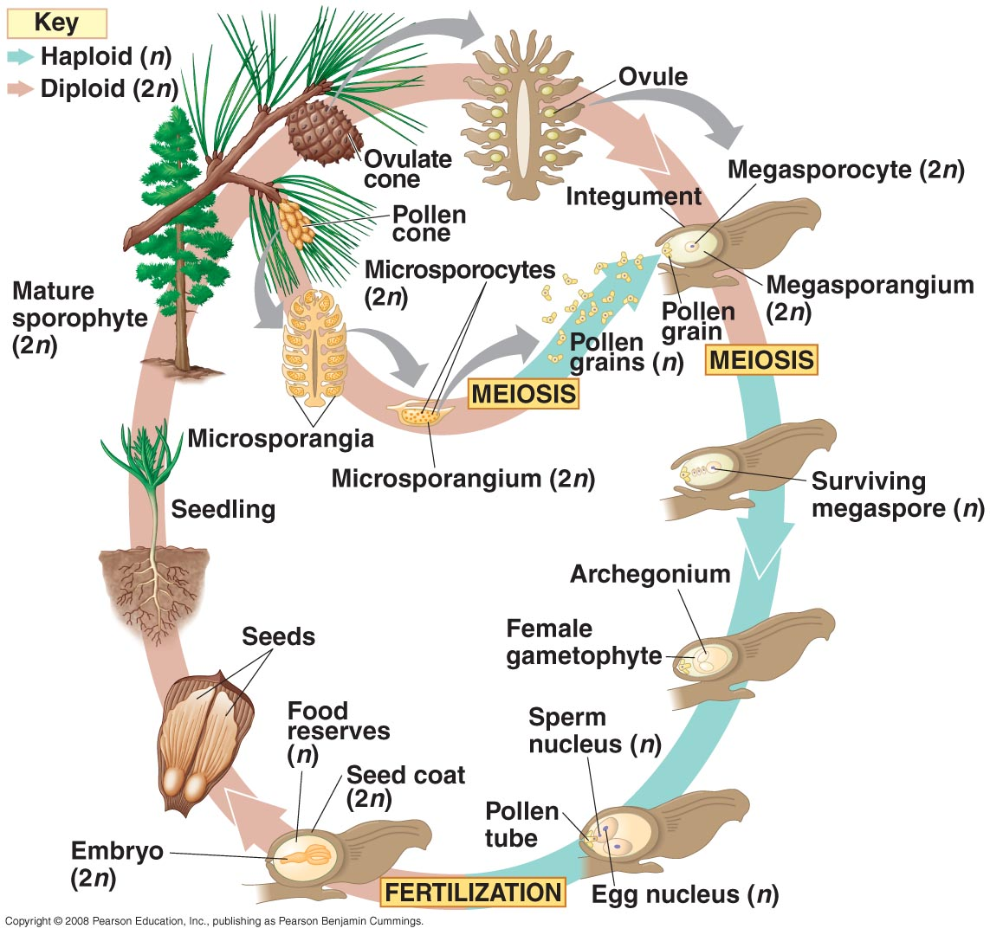

Slide 14
To complete the life cycle, a sperm will fuse with an egg to form a zygote, the first cell in the diploid, sporophytic generation.
For this to eventually happen, the first step is for the pollen to float through the air and land on top of a scale in the female cone.
The transfer of pollen from the male cone to the female cone is pollination.
When an ovule is receptive, a drop of sticky fluid is produced and fills the pollen chamber; some fluid exudes through the micropyle.
Pollen sticks in the fluid exuding from the micropyle. As the fluid dries, it and the stuck pollen are drawn in through the micropyle. The micropyle grows shut, entrapping pollen in the pollen chamber.

Slide 15
The pollen germinates and a tube digests through the megasporangium and into the megagametophyte. Eventually the pollen tube grows close to an archegonium and ruptures, releasing a sperm into the egg. The fused sperm and egg is the diploid zygote, the first cell in the sporophytic phase of the life cycle.
The zygote goes through cellular division, and after many divisions an immature sporophyte is developed within the ovule and is surrounded by the megagametophyte. The immature sporophyte is an embryo. While this is happening the outermost layer of the ovule, the integument, develops into the seed coat, which then forms a mature seed.

Slide 16
Economic importance of Gymnosperms
Construction purposes: Many conifers such as pine, cedar, etc., are sources of the soft wood used in construction and packing.
Medicinal uses: An anticancer drug Taxol is obtained from Taxus sp. Many species of Ephedra produce ephedrine, which can be used in the treatment of asthma and bronchitis.
Food source: The seeds of Pinus gerardiana (known as chilgoza) are edible and used in cakes and confectionaries.
Turpentine: Turpentine used in painting is obtained from Pinus roxburghii, Pinus insularis and Pinus wallichiana
Rosin: Rosin is a brittle, friable and faintly aromatic solid obtained from Pinus sp. is used commercially for Paper sizing,Varnish making, Making of soap, Sealing wax, Printer ink, Grease and lubricants.

Slide 17
Ornamentals: Gymnospermous plants are widely used as ornamentals. Conifers are often featured in formal gardens and are used for bonsai. Yews and junipers are often low-growing shrubs cultivated for ground cover and hedges. Conifers are effective windbreaks, especially those that are evergreen. Cycads are used as garden plants in warmer latitudes, and some may even thrive indoors.
Lumber: Most of the commercial lumber in the Northern Hemisphere is derived from the trunks of conifers such as pine, Douglas fir, spruce, fir and hemlock. Araucaria, kauri, and Podocarpus are important conifers of the Southern Hemisphere used for lumber. The wood is straight-grained, light for its strength, and easily worked.
Aromatic wood: Aromatic wood of cedar is frequently used in the construction of closets or clothes chests and apparently repels cloth-eating moths.
Paper making: Fibres of conifers make up paper pulp and are used largely in paper industry.

Slide 18
Leather tanning and garden mulch: Conifer bark is often the source of compounds involved in the leather tanning industry. Bark is also used extensively as garden mulch.
Copal: A hardened form of resin from a kauri (Agathis australis), called copal, is used in the manufacture of paints and varnishes.
Canada Balsam: Some resins, such as Canada balsam (Abies balsamea) is used in the preparation of mounting media for microscope slides. This resin does not crystallize on drying & has a high refractive index.
Amber: Many types of amber are derived from fossilized resin of conifers. Amber is used in X-ray therapy, in preparation of blood container, mouth pieces of pipes, cigarette holder, etc.

